Slide 1

Predictive Analysis: Building a Machine Learning Model for Patient Readmission Prediction
Group Members:
Raghav Aneja - 0811583
Patricia Vizcaino Castillo - 0813591
Kabesha Kalesh - 0812073
Chustine Jade Reyes - 0803808
Weijia Zhang – 0817669

Slide 2











CONTENT
Introduction
Problem Statement
Project Objective
Dataset Information
Dataset Exploration &Visualization
Why Machine Learning
Comparison of Model
Challenges
Conclusion
Reference

Slide 3
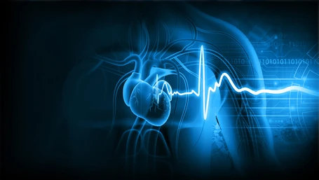
INTRODUCTION
Patient readmission is a major risk to both individual health and healthcare system costs, as it frequently indicates unresolved medical issues or inadequate post-discharge care.
Readmission may indicate that the initial treatment or care plan was ineffective or that the patient's condition deteriorated. This increases the patient's chances of experiencing complications, infections, medication errors, and other negative health outcomes.
Our goal is to analyze and assess the risk of patient readmission.
To achieve the project goal, we are utilizing machine learning algorithms, we aim to refine the prediction of readmission risks, thereby enhancing patient care and optimizing resource utilization.

Slide 4

PROBLEM STATEMENT
Analysis of patients' hospital admission and diagnosis records utilizing MIMIC-III Clinical Data to forecast the likelihood of readmission, thereby offering valuable insights for healthcare professionals to enhance diagnostic practices and mitigate the risk of patient readmission.

Slide 5


PROJECT OBJECTIVES
Analysis of patients’ records, accurately predicting the readmission based on several factors.
Success will be measured by the accuracy and reliability of the readmission risk assessment models.

Slide 6


DATASET INFORMATION
Data Sources:
PhysioNet, the Research Resource for Complex Physiologic Signal
MIMIC – III Clinical Database
Admission and Patient dataset
58,976 records
46, 413 unique patients
Types of features:
Objective: factual information (admission/discharge time, admission type);
Diagnosis: patients’ diagnosis per admission;
Subjective: information given by the patient (language, religion, marital status)

Slide 7
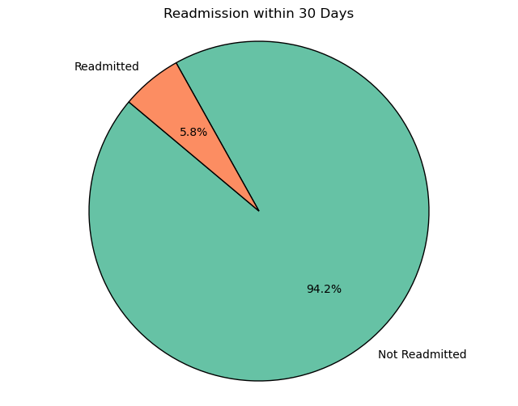
DATASET EXPLORATION & VISUALIZATION

Slide 8
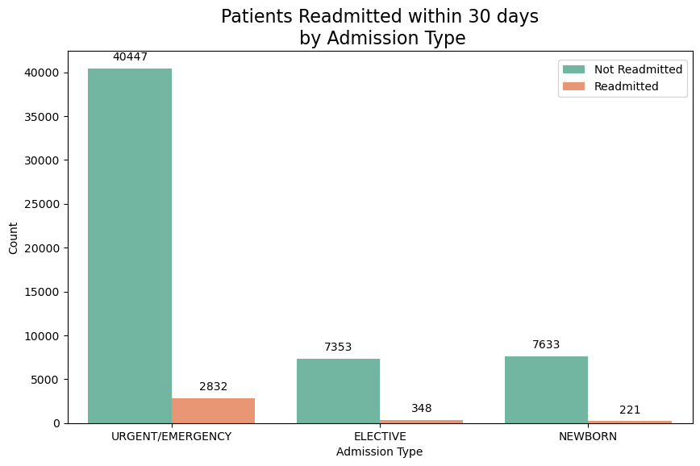
DATASET EXPLORATION &VISUALIZATION
2,832 out of 43,279 patients who were admitted through the urgent/emergency department were readmitted.
This suggests that most of the patients primarily seek medical attention for acute conditions or emergencies, emphasizing the critical role of emergency services in healthcare delivery.
6.5%
4.5%

Slide 9
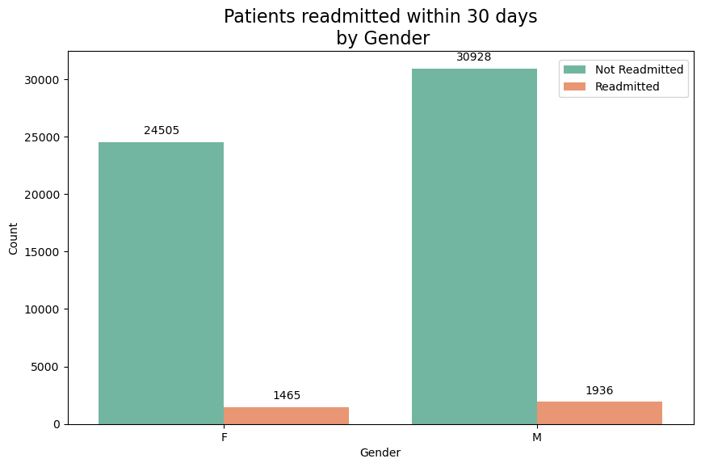
DATASET EXPLORATION &VISUALIZATION
There is a relatively balanced representation of gender, suggesting that there is no significant difference in the distribution of genders seeking medical care.
5.6%
5.9%

Slide 10
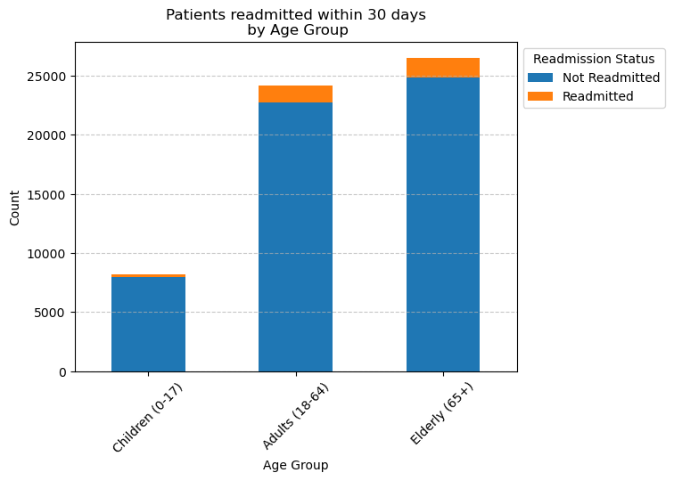
DATASET EXPLORATION &VISUALIZATION
1694
1480
Adults (18 – 64)
1,480 of this age group were readmitted within 30 days (approximately 6%).
Elderly (65+)
1,694 of this age group were readmitted within 30 days (approximately 6.4%).
The patients aged 18 and up are more likely to be readmitted compared to the patients below 18.
22691
24798
227
7944

Slide 11

WHY MACHINE LEARNING?
To effectively assess readmission risk factors and create predictive models that can forecast the likelihood of patient readmission using various variables in the MIMIC-III Admission Dataset.
To integrate machine learning findings into actionable insights for healthcare professionals, enabling proactive interventions and targeted strategies to reduce readmission rates and improve patient care outcomes.

Slide 12

MODEL EVALUATION

Slide 13

MODELS USED FOR PREDICTION
Logistics Regression
K Neighbors Classifier
Decision Tree Classifier
Random Tree Classifier
Gradient Boosting Classifier

Slide 14

ACCURACY OF THE MODELS
Models | Model accuracy for alive patients only | Model accuracy for all patients (dead and alive)
Logistics Regression | 70% | 67%
K Neighbors Classifier | 78% | 74%
Decision Tree Classifier | 90% | 87%
Random Tree Classifier | 95% | 93%
Gradient Boosting Classifier | 94% | 93%

Slide 15
Model Performance: Logistic Regression
ALIVE PATIENTS
ALL PATIENTS (DEAD AND ALIVE)
Accuracy | 70%
Accuracy | 67%
Confusion Matrix:
Confusion Matrix:
Actual Not Readmitted | 4967 | 2002
Actual Readmitted | 161 | 145
 | Predicted Not Readmitted | Predicted Readmitted
Actual Not Readmitted | 7511 | 3555
Actual Readmitted | 317 | 384
 | Predicted Not Readmitted | Predicted Readmitted

Slide 16
Model Performance: K Neighbor Classifier
ALIVE PATIENTS
ALL PATIENTS (DEAD AND ALIVE)
Accuracy | 78%
Accuracy | 74%
Confusion Matrix:
Confusion Matrix:
Actual Not Readmitted | 5609 | 1360
Actual Readmitted | 216 | 90
 | Predicted Not Readmitted | Predicted Readmitted
Actual Not Readmitted | 8514 | 2552
Actual Readmitted | 458 | 243
 | Predicted Not Readmitted | Predicted Readmitted

Slide 17




CHALLENGES
Too many datasets to be analyzed to appropriately choose the correct data for the modeling
Lack/minimal domain knowledge
Handling missing values
Class Imbalance

Slide 18

CONCLUSION
Patient readmission rate is a very sensitive subject and important to keep a closely track on it. This rate should be less than 14.5%.
The readmission of a patient into a hospital and proper treatment is extremely correlated with the type of symptoms and medical record of the patient.
For assessing the likelihood of patient readmission, the best model performance for our dataset and our analysis are Logistic Regression and K Neighbors Classifier.
For readmission predictions, the Logistic Regression and K Neighbors Classifier demonstrate the highest accurate rate for the testing dataset and recall scores.

Slide 19
REFERENCE
Dataset (Physionet):
Machine learning:
Images:
Johnson, A., Pollard, T., & Mark, R. (2016, September 4). Mimic-III clinical database. MIMIC-III Clinical Database v1.4. https://physionet.org/content/mimiciii/1.4/
Machine Learning Mastery. (2023, September 8). Machine Learning Mastery. MachineLearningMastery.com. https://machinelearningmastery.com/
Amin-Nejad. (n.d.). GitHub - amin-nejad/mimic-readmission-prediction: Master’s project. GitHub. https://github.com/amin-nejad/mimic-readmission-prediction
Google. (n.d). Google. https://www.google.com/webhp?hl=en&sa=X&ved=0ahUKEwia687NhMOFAxV8j4kEHZ3OChYQPAgJ

Slide 20


THANK YOU

